Slide 1
Off-axis Sensor Development Project Meeting/Update
2014.04.16

Slide 2
Off-axis Sensor (One Pager)
Description
Off-axis position sensor for motor position
Motivation
Provide economical solution of motor position sensing for Front-mount or Side-mount MPP configuration
Deliverables
Sensor System architecture
Recommendation for sensor selection
Design guideline for rotor feature (e.g. teeth geometry)
How to get absolute position
How to get redundancy
Timing
TBD
Team Members/Customers
Steve Collier-Hallman, Julie Kleinau, Ish Amin, Karl Terauchi/ PSA 1V5, SOP 2018
Concept Selection
Pugh Analysis
Criteria development
Pairwise Comparison
Sensor example from Sensitec

Slide 3
Off-axis Sensor Development WBS
1. Sensing Sub-system
1.1) System Requirements Flow-down
1.1.1) EPS System to Sensing Sub-system
1.1.2) Sensing Sub-system to Components
1.2) Specification
1.2.1) Sensing Sub-system Specification
1.2.2) Quote Spec for Components
1.3) Sensor System Architecture
1.2.1) Concept Options
1.2.1.1) Basic Architecture
1.2.1.2) Absolute Position Architecture
1.2.1.3) Redundancy Architecture
1.2.1.4) Fail Operational Architecture
1.2.2) Concept Selection
1.2.2.1) Criteria Development
1.2.2.2) Concept Selection

Slide 4
Off-axis Sensor Development WBS
2. Components
2.1) Sensor Selection
2.1.1) Candidates List
2.1.2) Evaluation
2.1.2.1) Cost
2.1.2.1.1) Schematic, BOM
2.1.2.1.2) Quote
2.1.2.2) Performance
2.1.2.2.1) Sensor Sample
2.1.2.2.2) Prototype Rotor
2.1.2.2.3) Test Machine Set-up, Fixtures
2.1.2.2.4) Run Test
2.1.2.3) Packaging
2.1.2.4) Timing (readiness/risk vs. applicable project timing)
2.2) Rotor Design
2.3) Other Elements

Slide 5
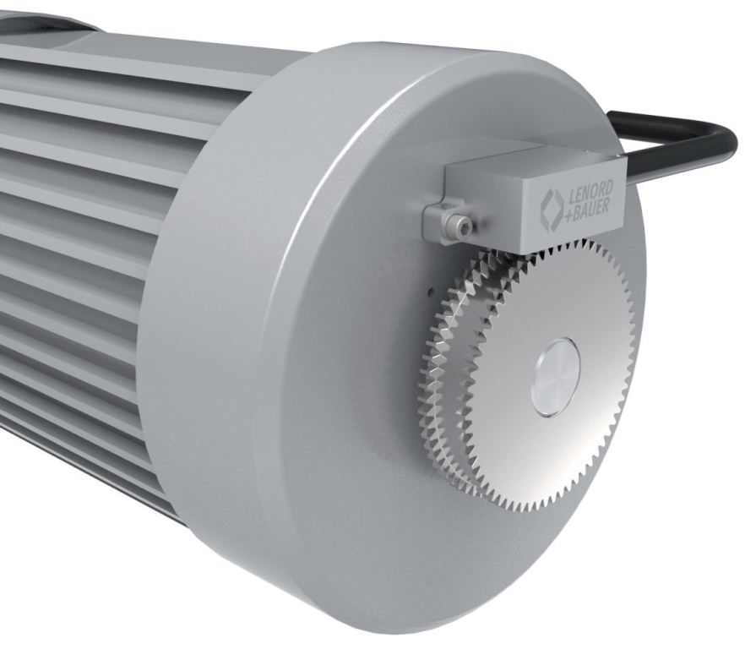
Reference An example in field

Slide 6
Reference Big-picture discussion (previous)
Saleable Product of Competitive
Traditional top three competitiveness factors
Low Cost
Compact Packaging
Low Mass
New requirement features
Fail operational
Technology combination mapping
something
Off-axis Sensor Technology
Sensor technology
Technology
Rotor design
Absolute position
Redundancy

